Slide 1



EDU-PREDICT
(BigData)
COMMITTED TO TRANSFORMING EDUCATION THROUGH DATA ANALYTICS

Slide 2

OUR TEAM
Mustufa Kashif
Student1371226
Syed Hamza
Saad Sarfaraz
Muneeb Khan
Student1372535
Student1379024
Student1372777
Owais Hayat
Rehman Ahmed
Zaryab Khan
Student1345409
Student1341239
Student1367910

Slide 3
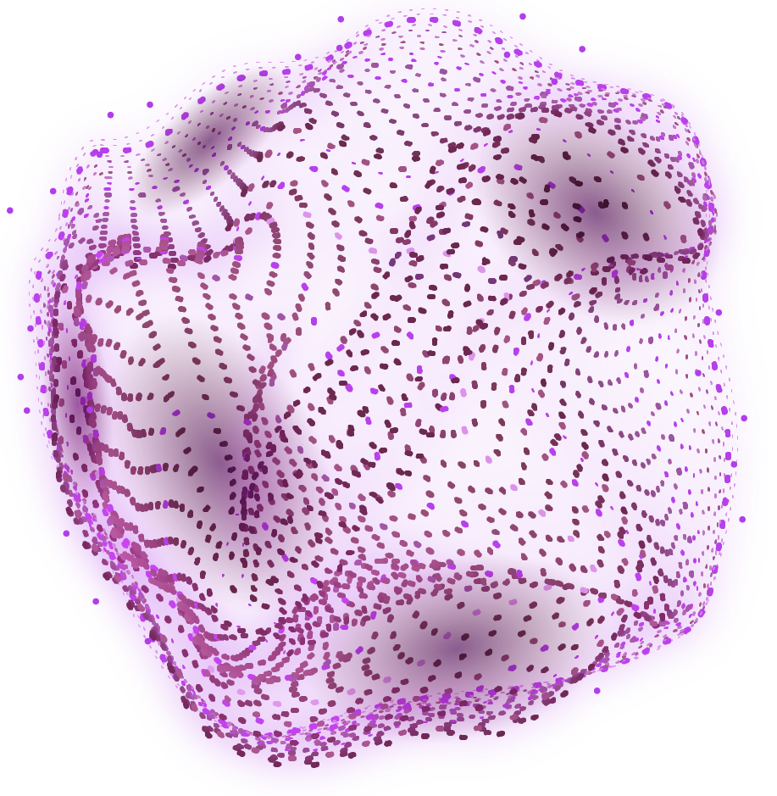
INTRODUCTION TO EDU PREDICT
The need for real-life project implementation in IT education.
In today’s IT education landscape, theoretical knowledge alone is no longer sufficient—real-life project implementation is essential to bridge the gap between learning and industry needs.
EduPredict emerges as a solution-focused initiative designed to integrate data analytics concepts within a live, interactive learning environment.
By guiding students through a step-by-step application of theory into practice, EduPredict enhances both technical competency and critical problem-solving skills.
This hands-on approach not only deepens understanding but also prepares learners for real-world challenges in educational and analytical domains.
Introducing EduPredict, a project aimed at applying concepts using live, synchronous learning environments.
The importance of applying theoretical knowledge in a practical, step-by-step approach.

Slide 4
OBJECTIVES OF EDUPREDICT
The primary goal of EduPredict is to provide students with immersive, practical experience in developing robust applications by simulating real-world scenarios. This experiential approach encourages learners to revisit, refine, and apply the tools and techniques they've acquired in a meaningful, project-based context. By structuring the learning journey into clear, progressive phases, EduPredict fosters a deeper understanding of core IT concepts while building confidence and competence. Ultimately, it adds substantial value to students' education by promoting hands-on learning, critical thinking, and real-time problem-solving.
Bridge Theory and Practice | Enable students to apply data analytics and IT concepts in real-world educational scenarios through practical, hands-on projects.
Enhance Skill Development | Develop critical thinking, problem-solving, and technical skills by engaging learners in live, synchronous learning environments.
Promote Data-Driven Decision Making in Education | Equip students and educators with tools and insights to make informed decisions using predictive analytics in academic settings.

Slide 5
Problem Statement
Education institutions worldwide face numerous challenges, such as declining student retention rates, inefficient resource allocation, and the need to personalize learning experiences.
At the same time, advancements in technology and data availability present significant opportunities to address these challenges through data-driven approaches.
By leveraging the capabilities of Hadoop and predictive analytics, EduPredict aims to overcome these challenges, capitalize on data-driven opportunities, and ultimately enhance the educational experience for the students.

Slide 6

SOLUTION OVERVIEW
GOAL 1
Predict student performance using data-driven methodologies to support early intervention and academic success.
GOAL 2
Optimize course design and delivery by analyzing learning patterns, engagement metrics, and academic outcomes.
Empower educators and stakeholders with real-time insights through machine learning and data visualization tools to enhance decision-making.
GOAL 3

Slide 7
SOFTWARE WE USE
Develop
Query
Data
Tools
Jupyter: Analysis
Anaconda: Distribution
RStudio: Statistics
Visual Studio Code: Editing
PyCharm: Development
Impala Server: for Querying
MongoDB Compass: GUI
Hadoop: Storage
Tableau: Visualization
Spark: Fast Processing
Kafka:Real-time stream
Matplotlib/
Seaborn/
Ploty: Python Based work

Slide 8
FUNCTIONAL REQUIREMENT
User Authentication and Authorization
Data Ingestion
Data Storage
Data Processing
Real-time Data Processing
Machine Learning Models
Data Visualization
Notifications and Alerts
Feedback and Support

Slide 9
NON-FUNCTIONAL REQUIREMENT
Performance
Data Security
Data Integrity
Reliability
Scalability
Performance Monitoring
Compliance and Standards
Documentation

Slide 10
OUR ASPIRATIONS
NOW
FUTURE
EDU-PREDICT harnesses real-time data streaming to process educational data—such as attendance, performance, and engagement—as it happens. This empowers educators and administrators with instant, actionable insights. By enabling immediate analysis, the system supports timely interventions, like identifying at-risk students early and addressing issues before they escalate.
Looking ahead, EDU-PREDICT aims to evolve into an AI-driven platform that not only analyzes performance but also personalizes learning pathways for each student. We envision expanding globally, integrating predictive career guidance, and partnering with institutions to transform education through data. By continuously innovating, we strive to shape a future where every student’s potential is not just measured—but maximized.

Slide 11
REAL-TIME DATA PROCESSING
Ensure seamless integration with batch processing for a comprehensive analysis
Integrate real-time data streaming capabilities
Real-time data processing empowers systems to handle and analyze information instantly as it is generated. By integrating real-time streaming, EDU-PREDICT can monitor student performance, attendance, and engagement live. This allows educators to make prompt, informed decisions and respond quickly to emerging issues. Real-time insights enable proactive interventions, improving academic outcomes and institutional efficiency.
While real-time data provides immediate insights, batch processing ensures deeper, historical analysis of large datasets. Seamlessly combining both allows EDU-PREDICT to balance speed with depth—offering instant feedback alongside long-term trends. This hybrid approach supports strategic planning and day-to-day responsiveness. It ensures a complete, data-driven understanding of student and institutional performance.

Slide 12
Machine Learning Models
Develop machine learning models for predictive analysis of student performance, dropout rates,
and course demand.
Include algorithms for anomaly detection, trend prediction, and correlation analysis.
Regularly update and refine models based on the latest available data.
20%
20%
20%
20%
20%
MLME1
MLME2
MLME3
MLME4
MLME5

Slide 13



DATA VISUALIZATION
Dashboard
Alerts
Customizations
Notifications
Interactive dashboards present complex educational data in clear, visual formats. Users can quickly view key metrics like student performance, trends, and patterns through charts, graphs, and heat maps.
The system highlights anomalies such as sudden grade drops or increased absenteeism. Visual cues flag issues early, enabling proactive interventions by educators and administrators.
Dashboards are fully customizable, allowing each stakeholder to filter, drill down, and interact with data based on their specific roles and objectives. This ensures meaningful, role-based insights.
EduPredict sends instant alerts when academic anomalies—like grade drops or attendance issues—are detected. This ensures timely intervention by teachers and administrators, supporting early corrective action.

Slide 14
AWESOME WORDS
Data is a precious thing and will last longer than the systems themselves.
“
____Tim Berners-Lee
”

Slide 15
System Reliability and Uptime
Aim for 99% uptime with scheduled maintenance.
Regular automated data backups to prevent data loss.

Slide 16
MAJOR REQUIREMENTS
SKILLS
INTELLIGENCE
Proficiency in using digital tools, dashboards, and interpreting analytics to enhance educational outcomes.
Ability to understand and interpret data-driven insights for smarter decision-making in academic environments.
ADAPTABILITY
FOCUS
Willingness to embrace new technologies and adjust strategies based on real-time feedback and trends.
Clear vision and goal-oriented mindset to prioritize student success and institutional growth through data.

Slide 17
Compliance & Standards
EduPredict strictly follows major data protection laws such as FERPA, GDPR, and institutional privacy guidelines. We ensure that student data is handled securely, with full transparency and user consent at every step.
Our platform aligns with educational data governance best practices to maintain high integrity and accountability. This ensures that all analytics and features operate within ethical, legal, and professional standards—building trust across all stakeholders.

Slide 18
PROJECT STAGES
VIDEO DEMONSTRATION
SOURCE CODE
Documenting all source code used in the project
Showcasing the working of the project.
DESIGN SPECIFICATIONS
TEST DATA
Include problem definition, flowcharts, and data diagrams.
Provide test data and project installation instructions.

Slide 19
PROJECT STRATEGY
Goal-Oriented Approach
User-Centered Design
Agile Methodology
Security & Compliance

Slide 20
OUR NUMBERS
50%
30%
20%
MANPOWER
DEVELOPMENT
EXPANSION

Slide 21
CONCLUSION
Revolutionizes education by leveraging powerful data analytics.
Empowers institutions to make smart, data-driven decisions.
Enhance student learning with personalized, targeted experiences

Slide 22
OUR LOCATION
Aptect Computer Learning
North Nazimabad, Block ‘A’, Near Board Office, Beside Froza Banquet

Slide 23
THANKS!
DO YOU HAVE ANY QUESTIONS?
mustufakashif37000@gmail.com
mustufa-kashif-portfolio.vercel.app

